Slide 1

ACCESS Testing Results
Spring 2025

Slide 2

Terminology
ACCESS: a test administered to students in grades K-12 who are identified as English learners.
English as a Second language (ESL)-Refers to our type of instructional delivery. Not a label for a student.
Multilingual Learner (ML)- Refers to student
  Revisions to Chapter 15 changed English Language Learner (ELL) to Multilingual Learner (ML)

Slide 3
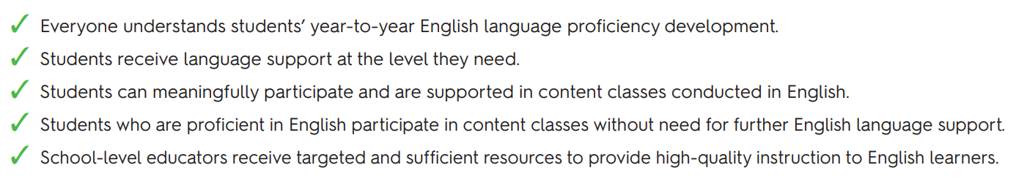
Purpose of ACCESS
Note: ACCESS test results are not intended to be used to measure ELA ability, determine special education or G&T placement, or evaluate teacher effectiveness
Notes:
https://wida.wisc.edu/sites/default/files/resource/ACCESS-Parent-Handout-English.pdf and https://wida.wisc.edu/assess/access

Slide 4
Multilingual Learners Across the District
Grade | Spr 21’ | Spr 22’ | Spr 23’ | Spr 24’ | Spr 25’
K | 5 | 5 | 5 | 10 | 9
1 | 3 | 9 | 10 | 10 | 11
2 | 1 | 5 | 7 | 15 | 11
3 | 5 | 3 | 10 | 10 | 12
4 | 5 | 8 | 8 | 7 | 7
5 | 2 | 3 | 8 | 10 | 6
6 | 1 | 1 | 7 | 9 | 9
Grade | Spr 21’ | Spr 22’ | Spr 23’ | Spr 24’ | Spr 25’
7 | 0 | 0 | 5 | 6 | 11
8 | 3 | 3 | 1 | 4 | 6
9 | 0 | 4 | 2 | 3 | 1
10 | 3 | 1 | 0 | 2 | 3
11 | 2 | 2 | 1 | 0 | 3
12 | 3 | 2 | 2 | 2 | 0
Total | 33 | 46 | 66 | 88 | 89

Slide 5
Home Languages
Arabic | Italian | Spanish; Castilian
Chinese | Kannada | Tajik
Georgian | Korean | Telugu
Gujarati | Malayalam | Turkish
Indo-European languages | Portuguese | Ukrainian
Indonesian | Russian | Urdu

Slide 6
Participation Rate
100%

Slide 7
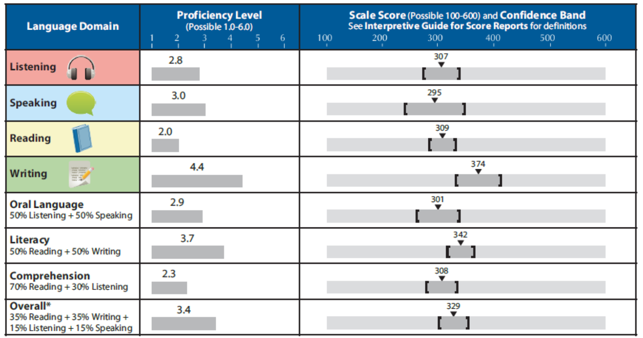
ACCESS Individual Student Report Sample
Notes:
https://wida.wisc.edu/sites/default/files/resource/ACCESS-Score-Reports-Parent-Guide-English.pdf

Slide 8
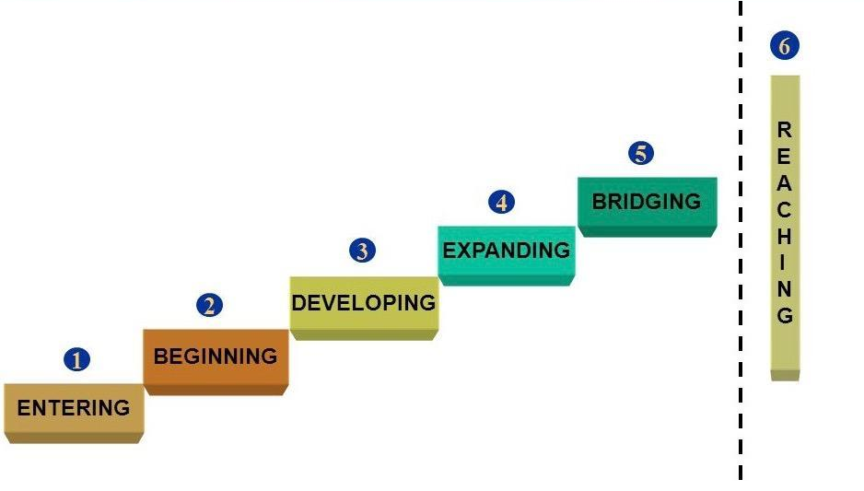
Interpreting the Data
Exit: 4.5

Slide 9
Score Distribution 2025
Composite Score | # of students tested | % of students tested
1-1.9 | 13 | 14.6%
2-2.9 | 12 | 13.5%
3-3.9 | 23 | 25.8%
4-4.4 | 26 | 29.2%
>4.5 | 15 | 16.9%

Slide 10
Score Distribution 2024 & 2025
Composite Score | 2024 # of students tested | 2025 # of students tested | 2024 % of students tested | 2025 % of students tested
1-1.9 | 12 | 13 | 14.8% | 14.6%
2-2.9 | 8 | 12 | 9.9% | 13.5%
3-3.9 | 23 | 23 | 28.4% | 25.8%
4-4.4 | 12 | 26 | 14.8% | 29.2%
>4.5 | 26 | 15 | 32.1% | 16.9%
Notes:
Difficult to track historical data as students move in and out of district. 2024 and 2025 have a similar enrollment number, however, we are not necessarily tracking the same students. That is why the NJ school performance data helps us understand if we are meeting our target goal.

Slide 11
NJDOE 2023-2024 School Performance Data
 | % of ML making expected growth | Annual Target
New Jersey | 29.5% | 29.6%
Moss | * | *
Campbell | 88.5% | 44%
Edgar | 52.6% | 22.7%
MHS | * | *
A student's expected growth is based on the student's initial year proficiency level and student growth expectations are increased by equal intervals each year so that the student meets the proficiency cut score of 4.5 within five years. An * indicates too few students to report.
From 2023-2024 School Performance Report (based on Spring 2024 data)
Notes:
https://rc.doe.state.nj.us/2023-2024/state/detail/academic?lang=EN This table shows the percentage of multilingual learners who demonstrated the expected amount of growth on the ACCESS for ELLs 2.0 Assessment for English Language proficiency. A student's expected growth is based on the student's initial year proficiency level and student growth expectations are increased by equal intervals each year so that the student meets the proficiency cut score of 4.5 within five years. The table shows the annual target for the percentage of students making expected growth.

Slide 12
Daily ESL Program
Push-in/Co-teaching model at Moss & CES
Pull out model at EMS & MHS
Sheltered English Instruction: K-5
  Integrates language development with content instruction to make academics more accessible
Double Block of ESL at EMS and MHS for POE
  ACCESS Scores 2.5 & Below
High Intensity Double Block ESL Services
  Spanish language speakers 6-12
Notes:
Point of entry

Slide 13
Student Interventions and Supports
HITG - High Impact Tutoring Grant
S.T.A.R. (Summer Tutoring for Accelerated Reading) Academy
Continued Creation of Multilingual Profiles
  Background information
  Can Do descriptors to guide instruction
  Recommended Accommodations
ML Parent Advisory Committee

Slide 14
Staff Professional Development
Annual professional development for all staff
Ongoing professional development for ESL teachers
  Support with new WIDA standards
  Designing and writing curriculum
Continuation of training content teachers K-5
  Sheltered English Instruction (SEI): Intensive 15 hour training for content teachers
  Co-Teaching
  Supporting Immigrant Students
Consultation between content teachers and ESL teachers
Utilize ESL consultant to build staff capacity

