Slide 1
District Goals 2022-2023

Slide 2
District Mission Statement
The Metuchen Public School District will provide all students with a safe and nurturing environment in which to foster academic, social and emotional growth. The District is committed to allowing every student to develop to their fullest potential by providing a strong foundation of skills based on academic excellence and high performance standards. The district expects all students to achieve the New Jersey Student Learning Standards at all grade levels. The district will provide a curriculum which is fully inclusive and recognizes the high expectations of the community.

Slide 3
District Priorities
We believe that students should be independent problem solvers, challenged through comprehensive and cohesive programming, particularly in science, technology, engineering, and mathematics.
We believe that a culturally-sensitive school climate in combination with career exploration and real-world experiences best prepares students for success.
We believe that quality instruction for students is contingent on best practices in recruitment, professional growth, and empowerment of staff.
We believe that student achievement increases with collaboration among all stakeholders.
We believe that up-to-date and modern school facilities ensure learning environments that support the health and well-being of all staff and students.

Slide 4
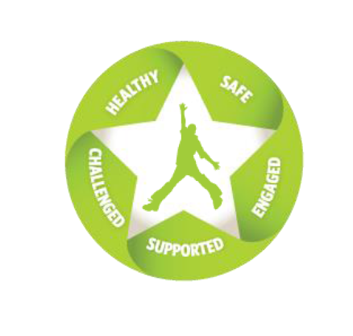
ASCD’s The Whole Child

Slide 5
Metuchen Public Schools 2022-2023 District Goals Overview
Healthy
Student toolkits for emotional health
Safe
Connections between students
Engaged
Civic engagement
Supported
Collaboration in support of student experiences
Challenged
Academic and social problem-solving
Sustainability
Space, assessment, and collaboration for long-term student success

Slide 6
Healthy Each student enters school healthy and learns about and practices a healthy lifestyle.
Goal: Utilize evidence-based instructional strategies to build student toolkits for emotional health and wellness.
Activities may include:
Consistency across the district with SEL and coping strategies
Telling vs. tattling
Dealing with anger management
Addictive behaviors
Mental health first aid

Slide 7
Safe Each student learns in an environment that is physically and emotionally safe for students and adults.
Goal: Facilitate connections between students
Activities may include:
Setting group norms
Racial inclusivity
People-first language
Student-to-student social connections
Taking different perspectives
Social conflict resolution

Slide 8
Engaged Each student is actively engaged in learning and is connected to the school and broader community.
Goal: Civic Engagement
Activities may include:
Research projects
Listening
Public speaking
Taking action
Community environmental impact
Literary magazines
Taking diverse perspectives
Media literacy

Slide 9
Supported Each student has access to personalized learning and is supported by qualified, caring adults.
Goal: Stakeholder collaboration in support of students and their academic experiences
Activities may include:
Scheduling
Grading
Articulation
Collaboration
RtI
Model transition practices
Student input
Adult-student interactions
Parent communication
Family involvement

Slide 10
Challenged Each student is challenged academically and prepared for success in college or further study and for employment and participation in a global environment.
Goal: Enriching learning experiences for students to enhance academic and social problem-solving skills
Activities may include:
STEM
American Sign Language
Embedded problem-solving in curriculum
Career and technical education opportunities
Foundational reading skills
STEM plan
Robotics
E-sports
Drones
United Nations Sustainable Development Goals

Slide 11
Sustainability Schools implementing a whole child approach use collaboration, coordination, and integration to ensure the approach’s long-term success.
Goal: Redesign space, review assessment practices, and use collaborative structures to support long-term success
Activities may include:
Space redesign
Feedback loop
Celebrating achievements
Mission statement
Assessment audit and deliverables
Assessment balance
Referendum

Slide 12
Measurements

Slide 13
Next steps
August 23 – public unveiling and board affirmation of goals
August 31/September 1 – share with staff, built-in time for reflection
Three public updates
Thanksgiving
Spring break
June

Slide 14
Here’s how we will self-assessing our progress in 22-23:
5
Did it well
with significant evidence of impact at student level
4
Did it well
and some evidence of impact at student level
3
Good progress
but not completed or limited evidence of student impact
2
Some progress
that was minimal or not at the student level
1
Didn’t do it
or circumstances prevented us from doing it

