Slide 1

Metuchen Public Schools “Every Moment Matters” District Goals 2025-2026

Slide 2
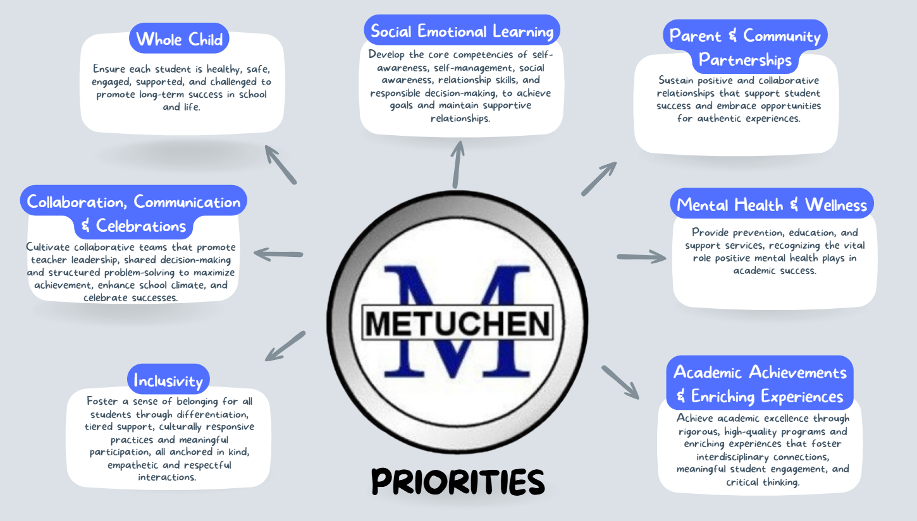
District Priorities

Slide 3
Metuchen Public Schools “Every Moment Matters”
Goal 1: Classroom & Community Engagement
Actively engage students in meaningful problem-solving experiences both inside and outside the classroom by integrating real-world issues and inquiry-based learning.
Goal 2: Building Forward Together
Foster collaboration and shared decision-making to navigate major organizational changes, using the construction project and grade realignment as catalysts to strengthen and transform our learning environments and operations.
Goal 3: Sky’s the Limit
Engage school communities through structured teams and processes in reviewing and acting on NJSCI data to drive continuous improvements in school climate.
Goal 4: Information Literacy
Equip students with critical thinking and sense-making strategies to identify, evaluate, and navigate a wide range of information across digital, academic, and everyday sources, empowering them to become informed, responsible, and engaged citizens.
Goal 5: The Best Me
Align and promote shared values, tiered supports, and targeted interventions, to empower students and equip staff in fostering positive and meaningful student interactions that promote success.

Slide 4
How will we measure our progress in 2025-2026?
5
Did it well
with significant evidence of impact at student level
4
Did it well
and some evidence of impact at student level
3
Good progress
but not completed or limited evidence of student impact
2
Some progress
that was minimal or not at the student level
1
Didn’t do it
or circumstances prevented us from doing it

Slide 5
District Goals: Goal #1
Classroom & Community Engagement
Actively engage students in meaningful problem-solving experiences both inside and outside the classroom by integrating real-world issues and inquiry-based learning.
Key actions for 2025-2026:
Teach students about food equity, reduce food waste and provide reliable sources of nutritious meals to those in need through share tables, donations to a food pantry, and community partnerships.
Empower student leaders and engage the community in environmental stewardship through hands-on tree-related education, promoting the benefits of trees, and strategically planting new trees across school campuses with grant support.
Enhance critical thinking and deepen understanding in STEM subjects by implementing strategies from book studies (i.e., Building Thinking Classrooms; Gather, Reason, and Communicate, etc.), facilitating differentiated center-based activities, and using real world contexts.
Mean score = 3.50 (range = 1 to 5)
Moss: Planned collaboration with MHS Honors Math Classrooms for authentic learning experience (math applications and donations to FPC)
Campbell: students independently selected strategies, revised their thinking based on peer feedback, and sustained academic discourse, indicating a high level of cognitive demand and ownership of learning.
Edgar: Students continue to collect unused food during every lunch period every day. Students visit the farm stand throughout the afternoon if they are hungry. They also bring food to the nurse's office for students.
MHS: Tree Ambassadors reviewed and provided feedback on final tree planting plans

Slide 6
District Goals: Goal #2
Building Forward Together
Foster collaboration and shared decision-making to navigate major organizational changes, using the construction project and grade realignment as catalysts to strengthen and transform our learning environments and operations.
Key actions for 2025-2026:
Update standards-based report cards and align grading and reporting practices for new grade configurations.
Collaboratively reimagine instructional experiences that extend the core (i.e., G&T, RtI, ESL, science lab, library, computers, PE/health, world language, music, art)
Clarify a common understanding of Metuchen’s model of collaboration through teacher leadership.
Coordinate staff assignments to support the smooth transition of students between schools, ensure continuity of instruction, and provide consistency in student support.
Plan for the use of new learning spaces that maximizes opportunities for innovation, supports teaching and learning, and enhances student engagement and collaboration.
Mean score = 3.30 (range = 1 to 5)
Moss: Reimagining K-2 Specials - Collaboration regarding programming in new spaces
Campbell: 5th grade team participating in SLT since last year. Special meetings added with 5th grade team to ensure their inclusivity and preparation.
Edgar: The SLT collaborated on an AI Chatbot geared to helping students identify careers of interest. The results were shared with all teachers to make connections between their content and careers.
MHS: Continued work on reviewing grading profiles was accomplished to ensure appropriate reporting of first semester grades and GPAs to colleges/universities.

Slide 7
District Goals: Goal #3
Sky’s the Limit
Engage school communities through structured teams and processes in reviewing and acting on NJSCI data to drive continuous improvements in school climate.
Key actions for 2025-2026:
Collaborate with parent advisories, student advisories, school leadership teams, committees, and ad hoc teams to analyze school climate data and related practices.
Engage in shared decision making to develop and implement action steps aligned to identified areas for growth.
Mean score = 3.75 (range = 3 to 4); highest goal and biggest increase
Moss: Moss SLT paired with CES staff who are moving next year to define and problem and select a focus. Focus was on "the Moss School way" for assisting students through tiered supports.
Campbell: Action steps based on Winter Data include the following: Strengthening Learning for All. Expand enrichment & STEAM opportunities. Increase challenge and support across all levels. Review pacing and instructional practices
Edgar: We have completed 2 No Place for Hate lessons that were developed collaboratively with Student Support Services team based on trends seen in student behavior-i.e: Empathy. The Bulldog Values were created in collaboration with the Union leadership as a result of the NJSCI data.
MHS: Survey results from the MHS Attendance Parent Survey was reviewed by all advisories and teams to help determine additional ways to facilitate a home-school connection that would ensure better attendance practices.

Slide 8
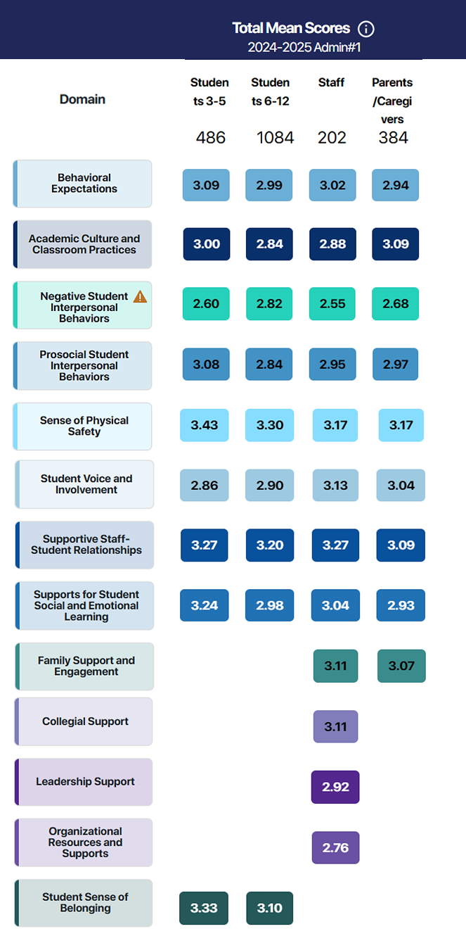

Slide 9
District Goals: Goal #4
Information Literacy
Equip students with critical thinking and sense-making strategies to identify, evaluate, and navigate a wide range of information across digital, academic, and everyday sources, empowering them to become informed, responsible, and engaged citizens.
Key actions for 2025-2026:
Engage students in collecting, analyzing, and interpreting real-world data using mathematical tools such as graphs, statistics, and data representation, and guide students in evaluating the reliability and limitations of data sources.
Implement an Artificial Intelligence (AI) Plan with tools for screening and curating resources and provide staff with “pick your own path” professional development opportunities, including prompt engineering and responsible AI use.
Emphasize voting rights and voter registration processes to build civic readiness, ground instruction in primary documents, incorporate current events where students pick, summarize, and evaluate information, foster respectful debate, and understand how geography influences cultures, societies, and nations.
Mean score = 3.42 (range = 2 to 5)
Moss: Kindergarten Morning Meeting Classroom Inclusion of a "Daily Bar Graph" using student votes "Would you rather...“
Campbell: Students engaged in analyzing data sets connected to real-world contexts, using graphs and visual representations to interpret trends and draw conclusions. Students discussed the accuracy and limitations of the data, with teachers prompting them to consider the source and reliability
Edgar: All students have been trained in the district AI guidelines. Every classroom has the district AI guidelines posted on the wall. Students and staff were trained on the use of Notebook LM.
MHS: Share My Meals data is shared out monthly via district newsletter by Environmental Club students. Teacher lessons on reliability of AI January In-service sessions on media literacy and source reliability Slow reveal graphs are being used in classrooms to engage students in interpreting data and identifying the strengths and weaknesses presented in the data sets.

Slide 10
District Goals: Goal #5
The Best Me
Align and promote shared values, tiered supports, and targeted interventions, to empower students and equip staff in fostering positive and meaningful student interactions that promote success.
Key actions for 2025-2026:
Engage school-based teams to review and set behavioral expectations for positive student interactions and empower students with the strategies to foster healthy relationships.
Align interventions, services and character education programs to the NJ Tiered Systems of Support (NJTSS) framework.
Provide professional development on tiered interventions for areas beyond academics (i.e., mental health, social emotional learning, behavior, etc.)
Mean score = 3.50 (range = 2 to 4)
Moss: Rotating Lunch Bunch Groups on Targeted Interventions (i.e. coping skills, building friendships, anxiety)
Campbell: Lightbulb Lunch group will develop expectations matrix aligned to the new touchstone
Edgar: We have been focusing on Tier 1 Character Education through Advisory lessons, No Place for Hate Lessons, morning announcements about our monthly Character Ed themes, as well as the Bulldog Values.
MHS: MHS Chronic Absenteeism issue is examining how to formalize the actions being taken as a three-tiered system approach.

Slide 11
District Goals & Alignment to ASCD's Whole Child Tenets
Goal # | Healthy | Safe | Engaged | Supported | Challenged | Sustainability
1 |  |  | x | x | x | x
2 |  | x |  | x |  | x
3 |  | x |  |  |  | x
4 |  |  | x |  | x
5 | x | x |  | x |  | x
Score for each tenet →

Slide 12
District Goals & Alignment to School Quality Review Indicators
Goal # | 1 curriculum | 2 pedagogy | 3 assessment | 4 environment | 5 expectations | 6 resources | 7 goals | 8 supervision | 9 shared leadership | 10 improve-ment | 11 student growth
1 | x | x | x |  |  |  |  | x
2 |  |  | x |  |  | x | x |  | x
3 |  |  |  | x |  |  | x |  | x | x
4 | x | x | x |  |  |  |  | x
5 |  |  |  | x | x |  |  | x |  |  | x
Score for each indicator→

