Slide 1
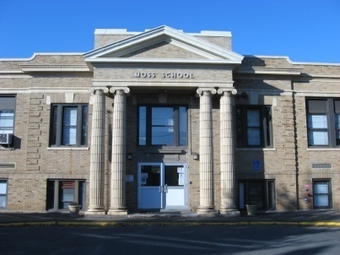
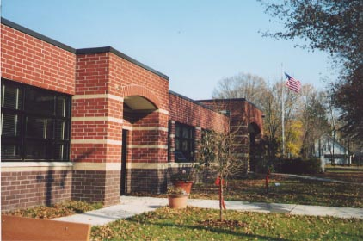
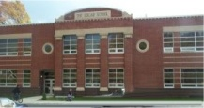
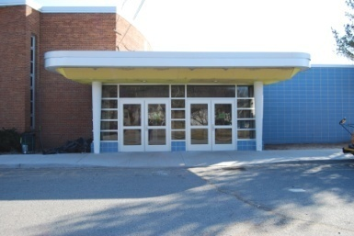
Metuchen Public Schools
Budget Hearing Presentation
2022-2023
School Year
Handout #1 April 26, 2022

Slide 2
Budget Preparation Timeline
July/August 2021 - Budget Preparations begin.
September/December 2021 - Principals prepared school based budget with input from all stakeholders.
December 2021 - The Superintendent and Business Administrator reviewed the submitted budgets.

Slide 3
Budget Preparation Timeline
December 2021 – April 2022 Presentations at Board of Education Meetings.
March 10, 2022– State Aid Information was received.
March 22, 2022– Preliminary Budget Hearing.
April 26, 2022– Final Budget Hearing.

Slide 4
21/22 Highlights Metuchen High School
2021-2024 NJ Sustainable Schools Bronze Level Award Recipient
Class of 2021 – 93.5% of students pursued higher education.
School-Wide Initiatives
Use of assessment data to drive instructional decision making.
Implementation of Response to Intervention programming.
Supporting gender identity and expression (staff training, gender-inclusive restroom).
Community Outreach
Soccer for a Cause Charity Festival
Combined $17,000 Donation to Go4theGoal and Marisa Tufaro Foundation
1,500+ pounds of food donations to REPLENISH
Safety Ambassadors Program for Campbell First Graders in association with Robert Wood Johnson University Hospital
Academic Highlights
2022 National Merit Scholarship Program
Eight Commended National Merit Scholarship Students
One 2022 National Merit Scholarship Finalist
Advanced Placement Program
173 Students Took AP Exams, 383 Exams Taken
74% of students receiving a 3 or higher, 51% of students receiving a 4/5.
Co- and Extra-Curricular Highlights
MHS Tournament of Bands Region XII Champions
MHS Footlighters Fall Production: All Together Now!
Increase in Club Offerings including: African-American Club, Bring Change to Mind, Dungeons & Dragons Club, and Game Club.
Athletics Participation
Fall 2021 – 284 students (39% of school population).
Winter 21-22 – 174 students (24% of school population).

Slide 5
21/22 Highlights Edgar Middle School
2017-2022 New Jersey Sustainable School Bronze Level Award Recipient
School-Wide Initiatives
Implementation of Wingman and Advisory
Student led announcements created and presented by our Tech Club
Spring Musical- School House Rock Jr.
Data focused PLCs
RTI Committee with a holistic approach for identifying students
Culturally responsive student activities including reading the Pledge of Allegiance in different languages.
Schoolwide staff book discussion of Melissa
Community Outreach
Adopt-a-Family
Participated in Drives-Clothing drive for homeless, Sock drive, Replenish
Student Council activities with donations to several organizations
Academic Competitions
First Lego League Competition

Slide 6
21/22 Highlights Campbell Elementary School
New Jersey School of Character Designation with National Application under review
New Jersey Sustainable Schools Silver Level Award Recipient
School-Wide Initiatives
“Dr. C’s Pledge Club”, which has been featured on Metuchen Television, served as a strategy for the new principal to build relationships with children, by embedding social emotional learning (SEL) competencies into everyday building operation.
Continued implementation of Social Emotional Learning Competencies & Sub-Competencies
Expanded implementation of Campbell’s N.E.S.T. Program in collaboration with Rutgers to support Metuchen’s Mental Health Initiative
Focus on data analysis to drive math & English language arts instruction through quarterly data meetings
Professional development to teach adults how to embed coping skills into classroom practices
Increased focus on targeted interventions utilizing Response to Intervention Programming that supports struggling students in math and reading
Community Outreach
Principal’s Reading Challenge to support good reading habits garnered participation from every child in Campbell Elementary
First Aide supplies collected for Ukraine and sponsored by the Girl Scouts
Tremendous community support for school-based drives (e.g., Replenish Drive, Clothing Drive & Pet Supplies Drive)
“Campbell Friday Three” Videos highlighted weekly happens and upcoming events
Monthly Coffee or Tea with Dr. C. at Cai’s Café sponsored by Campbell/Moss PTO

Slide 7
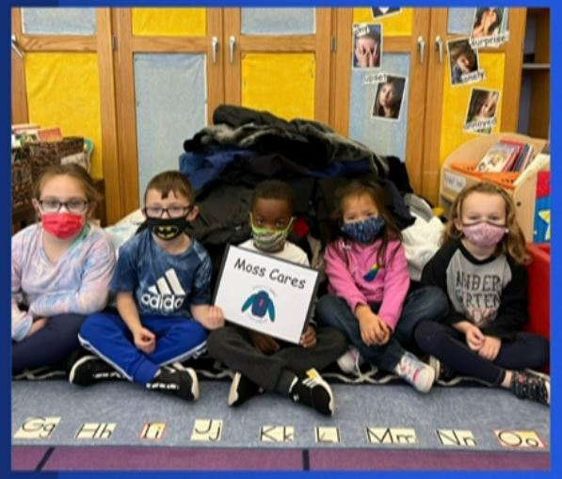
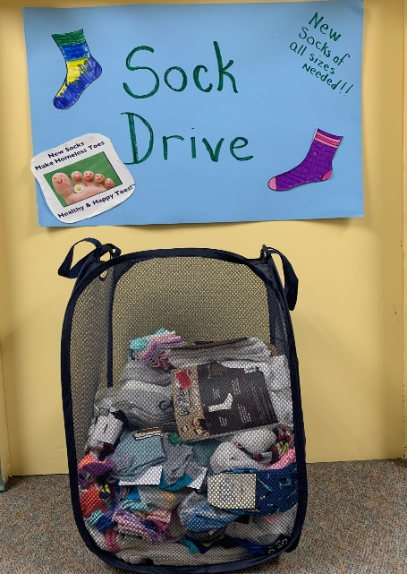
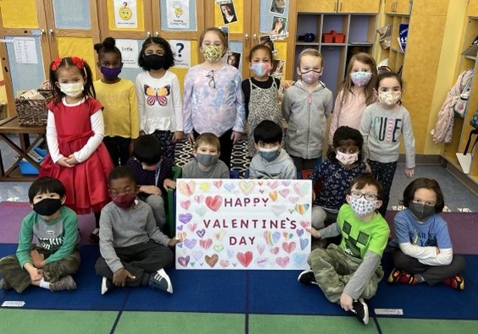
21/22 Highlights Moss Elementary School
New Reading Assessment Tools
DIBELS (foundational skills)
Fountas and Pinnell (comprehension)
Foundational Skills Instructional Pilot Materials
Data driven Mini-lessons (3-5 minutes) on foundational skills
OG
Heggerty
Math Tool
Kathy Richardson Resources
School-wide PD - Embedding SEL through Metacognition
Social Awareness
Coping Skills (Self Awareness/Management/Responsible Decision Making)
Moss SLT
Staff wellness and data driven improvement goal of increasing Staff Efficacy
Rutgers Collaboration SLT Co-chair Training
Teaching Empathy
Coat Drive -70 Coats
Food drive 10 FULL CONTAINERS
Sock Drive – On going
Valentines Cards and Posters to Veterans home

Slide 8
Special Education Focus Areas
Specialized Programs & Related Services
Specially designed instruction, related services, specialized evaluations, consultation & collaboration with specialists, work based learning, community based instruction, meaningful inclusion, augmentative and alternative communication, targeted professional development
Counseling and Behavioral Supports
Direct services in counseling, social skills groups, behavior support plans, consultation with specialists, staff training
Literacy Intervention
Reading intervention services, professional development, coaching, progress monitoring

Slide 9
Mental Health Initiative Focus Areas
Students
Social Emotional Learning
Problem Solving Strategies
Coping Skills Strategies
Learning Strategies
Transition Support
Counseling Services
Positive Behavioral Support
De-escalation & Crisis Intervention
Education & Awareness
Acceptance & Assistance
Academic Support
PREVENTION
EDUCATION
Staff
Parents
Professional Development
Staff Wellness
Consultation with Specialists
Parent Education
Resources
Community Referrals
SUPPORT

Slide 10
Mental Health Referendum Components
School Psychologists
Services expanded at all schools with
two new positions
Therapeutic Programs
Clinicians added at Campbell & Edgar
and continued at MHS
Academic Interventions
Reading Specialist
Math Intervention Teacher
Increased Response to Intervention services
Individualized intervention plans
Learning Strategies programs
Behavioral Support
Increased support from Board Certified Behavior Analysts district wide
Clerical Support
Part time secretary added to increase efficiency and availability of support staff for direct services

Slide 11
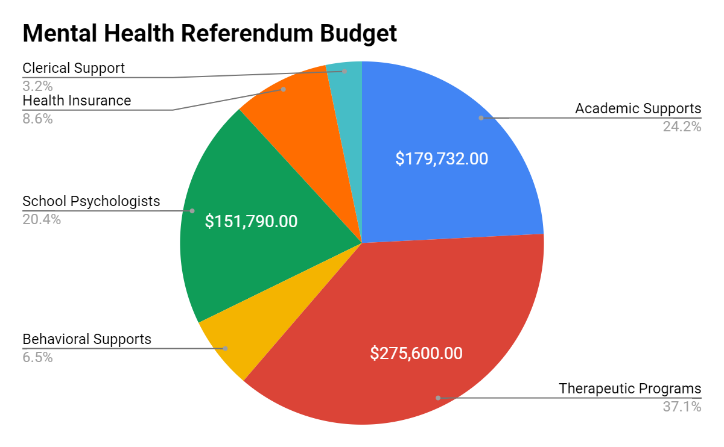
Mental Health Referendum Budget
$23,957.00
$63,753.00
$48,014.00

Slide 12
22-23 Proposed Budget/Curriculum
Curriculum Revisions:
Summer 2022: Social Studies, ESL,Technology and other half of PE/Health
Supplies:
Student SEL Tech Intervention Tool Pilot
Professional Development:
Problem-Based Learning
AP Courses
Supervisors
Mentoring
State Mandated
Frontline - Professional Growth Software for Data Management of:
Teacher Evaluation
Staff Professional Development

Slide 13
22-23 Proposed Budget/Technology
1:1 devices for rising 5th and 9th grade students
New tech for Guidance, Special Services
Papercut printers replace some network printers
Network security training – staff and teachers
Classroom projector upgrades

Slide 14
Status of Network Infrastructure
Wiring – 10GB to all wireless and offices in 17/18
Switches – continuing to replace switches to build out 10GB+ throughput districtwide; some upgrades occurring to increase bandwidth to selected APs
Servers – Server NICs upgraded to 10GB
Firewall – replacing Summer 2022
Internet – Increased to 1 Gbps in 2020; considering additional backup internet as redundancy, augmentation
Access points – upgrading 36 aging
Fiber backbone – Fiber upgrades completed at three schools to allow 10GB+ throughput districtwide
WAN – considering increase from 1GB to 10GB between buildings for SY 23-24

Slide 15
Budget/Facility/Safety
Continued proactive maintenance of all district buildings and athletic fields
Continued parking lot maintenance at all buildings
HVAC Upgrades
Roofs – repairs

Slide 16
Adjustments Made to Preliminary Budget
Addition of Funds for Transportation Contracts - $350,000
Reduction in Health Insurance Line - $350,000

Slide 17
THE SCHOOL BUDGET INCLUDES:
FUND 10 – The General Fund -
or Operating Fund
Provides for:
- support of programs and services
- day-to-day operations
2022-2023 Budget Appropriations
Fund 10 $45,522,501
2021-2022 Budget Appropriations
Fund 10 $44,876,429

Slide 18
THE SCHOOL BUDGET INCLUDES:
FUND 20 – The Special Revenue Fund
- federal and restricted state aid
- legally restricted for special purposes such as Special Education
- No Child Left Behind monies
2022-2023 Budget Appropriations
Fund 20 $1,571,285
2021-2022 Budget Appropriations
Fund 20 $1,180,285

Slide 19
THE SCHOOL BUDGET INCLUDES:
FUND 30 – The Capital Project Fund
- is used to account for capital projects

Slide 20
THE SCHOOL BUDGET INCLUDES:
FUND 40 – The Debt Service Fund
accounts for money to be set aside to pay the interest and principal on long-term debt such as bond issues
2022-2023 Budget Appropriations
Fund 40 $2,500,478
State Aid Amount $234,977
2021-2022 Budget Appropriations
Fund 40 $2,508,731
State Aid Amount $236,708

Slide 21
Summary of Appropriations
Salaries | $27,466,689
Health Insurance | $5,815,592
Tuition/OT-PT/Speech/Mental Health | $3,200,905
Transportation Contracts | $1,857,572
Instructional Supplies/Textbooks | $1,132,659
Payroll Tax/Pension | $1,136,600
Utilities | $744,464
Insurance P&C etc. | $497,500
Contracted Services | $442,143
Professional Development FFPI | $156,635
Supplies | $223,580
Legal/Audit/Architect | $153,000
Athletic Operating Costs, Environmental Costs, Camping Trip (800 Series Account) | $394,848
NJ DOE Assessment | $100,314
Increase Cap Reserve | $2,200,000
 | $45,522,501

Slide 23
Revenue
Local Tax Levy | $40,542,826
State Aid | $2,492,089
Budgeted Fund Balance | $2,147,585
Transportation Revenue | $275,000
Miscellaneous Revenue | $40,131
Medicaid Reimbursement | $24,870
Total | $45,522,501

Slide 24
$40,542,826

Slide 25
State Aid
Special Education Aid
Categorical Transportation Aid
Categorical Security Aid
Total 2022/2023 Aid
$2,107,539
$226,496
$158,054
$2,492,089

Slide 26
TAX IMPACT – Fund 10 and Fund 40
Metuchen Ratables
School Tax Levy
School Tax Rate per hundred (=42,808,327/1,098,324,300 * 100)
School taxes on a house assessed at $211,143
(=21.11 * 3.898* 100)
School tax increase on a house assessed at $211,143 (8228-8125)
Percent increase over 2021/2022
$1,098,324,300
$42,808,327
3.898 $8,228
$103
1.3%

Slide 27
TAX IMPACT – Incremental Operating Costs
Metuchen Ratables
School Tax Levy
School Tax Rate per hundred (=800,000/1,098,324,300 * 100)
School taxes on a house assessed at $211,143
(=21.114 * .073* 100)
Percent increase over 2021/2022
$1,098,324,300
$800,000
.073 $154
1.9%

Slide 28
Budget Efficiencies
Integrated Preschool Program.
Refinanced bonds whenever cost effective.
Transportation jointures with other school districts.
Participation with the ESCNJ for mandated services to non-public schools, transportation jointures, and out-of-district special education placements.
Participation in Federal E-Rate program.
Natural gas and electricity consortia with other high volume users.
Gasoline purchases through the Borough.
Cooperative purchasing with other school districts.
Implementation of least restrictive self-contained programs at all schools.
Participated in the New Jersey Clean Energy Program.
Completion of Energy Audit.

Slide 29
Ballot Questions – November 8, 2022
Ballot Question #1 – Capital Question for improvements and additions to all four schools
Ballot Question #2 – Operating question to cover incremental operating costs of Full Day K and grade realignment
Ballot Question #3 – Capital Question for new gymnasium and returfing of the MHS Athletic Field

